Slide 1
TURKIYE STUDENTS EVALUATION DATASET
BY
KRANTHI KUMAR
ANNU ARCHITHA
SUMANTH
B VENKATA SAI CHIRASMAYEE

Slide 2
PROBLEM STATEMENT
Turkiye Students Evaluation is an Unsupervised Learning Problem
Problem- Use Classification and Clustering Technique to deal with given data
About Dataset-This dataset is based on an evaluation form filled out by students for different courses. It has different attributes including attendance, difficulty, score for each evaluation question, among others. The dataset has 5820 rows and 33 columns. Among the 33 columns, there are instr, class, nb.repeat, attendance and difficulty columns and the rest 28 columns are questions asked to the students and a student’s response is recorded for every question.

Slide 3
OUR APPROACH:
Our goal in this project is to group the students based on the similarity of their answers in the survey. Notice that we don’t know how many cluster (group) of students will be.
In fact, we will use different methods of clustering to decide the best “natural” number of groups of this dataset. We will attempt to perform k-means clustering technique to monitor and assess the student performance and behavior as well as give improvement toward e-learning system in the future.
The challenge in this project is that we do not have the labelled data and our algorithm must be able to cluster such that intra cluster similarity must be high and intra cluster similarity must be low. This dataset is based on an evaluation form filled out by students for different courses. It has different attributes including attendance, difficulty, score for each evaluation question, among others. The dataset has 5820 rows and 33 columns.

Slide 4
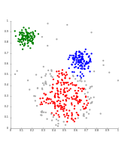
CLUSTERING
Cluster analysis or clustering is the task of grouping a set of objects in such a way that objects in the same group (called a cluster) are more similar (in some sense) to each other than to those in other groups (clusters). It is a main task of exploratory data mining, and a common technique for statistical data analysis, used in many fields, including pattern recognition, image analysis, information retrieval, bioinformatics, data compression, computer graphics and machine learning.
To solve our clustering problem regards to Turkiye student dataset we are using k-means and hierarchical clustering algorithms.
Clustering is used for many applications like Biology, computational biology and bioinformatics, Business and marketing, Customer segmentation, World Wide Web etc.
We are using clustering algorithms for Turkiye Student Dataset to divide the different behaviors of students into clusters.

Slide 5
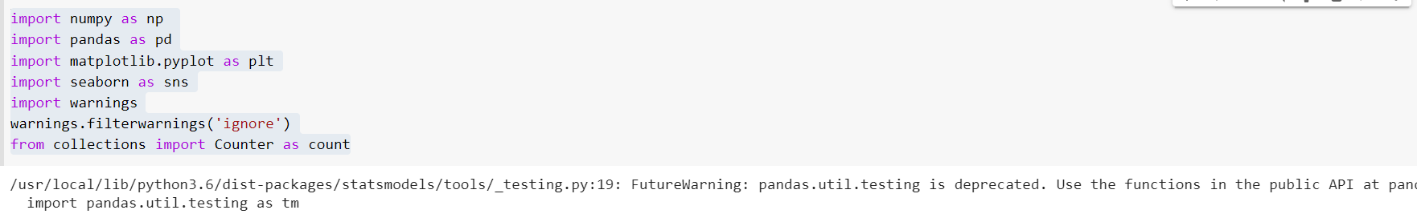
Importing the libraries

Slide 6
Importing the dataset

Slide 7
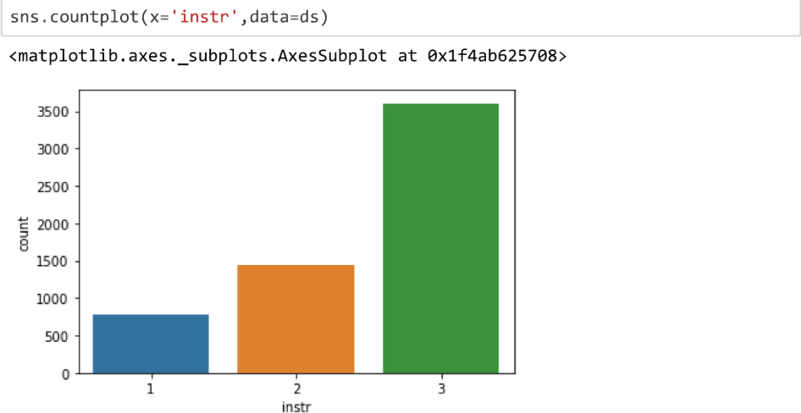
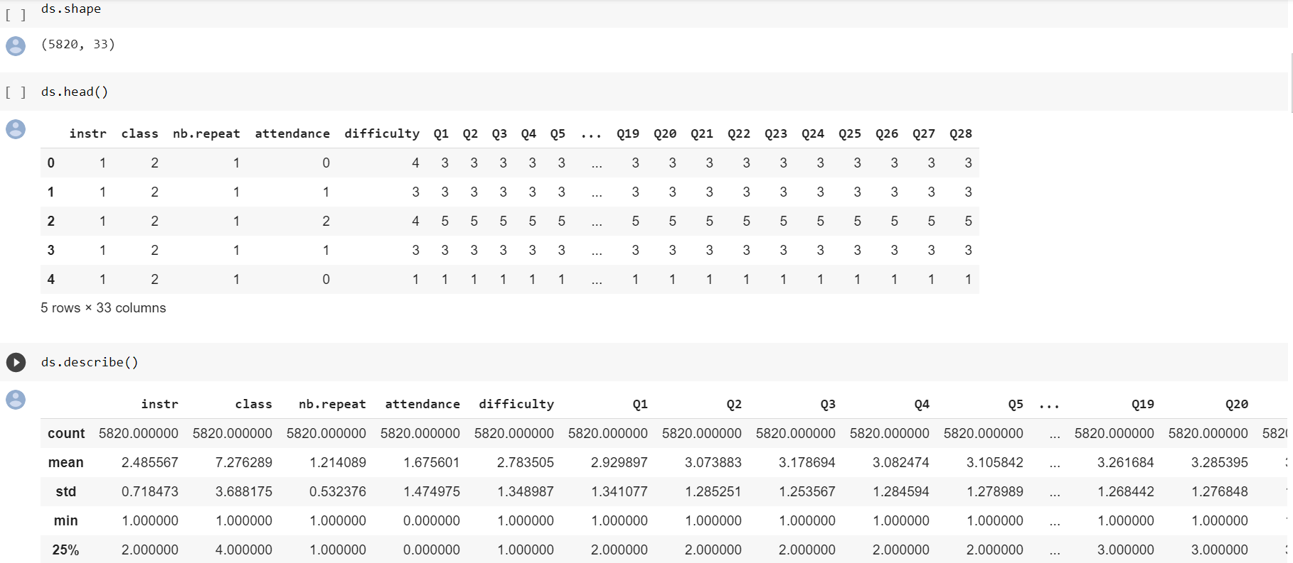
Visualizing the dataset

Slide 8
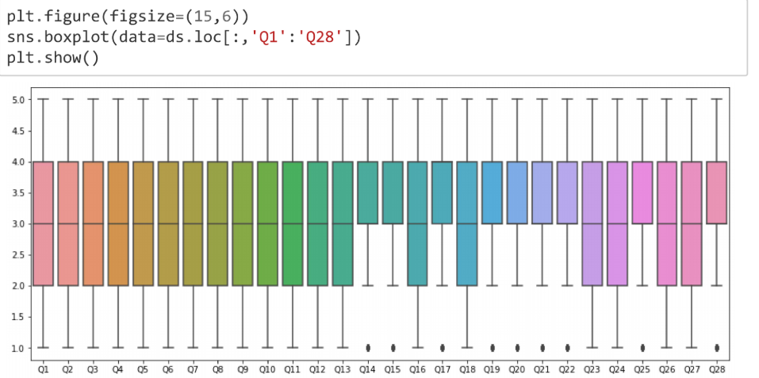
The number of responses of some classes is clearly much lower compared to the rest. Doing a little bit more analysis, we could see that the 3rd instructor taught 7 classes: class no 3, 4, 5, 8, 9, 12, and 13.
Let's plot the boxplot on questions’ columns.

Slide 9
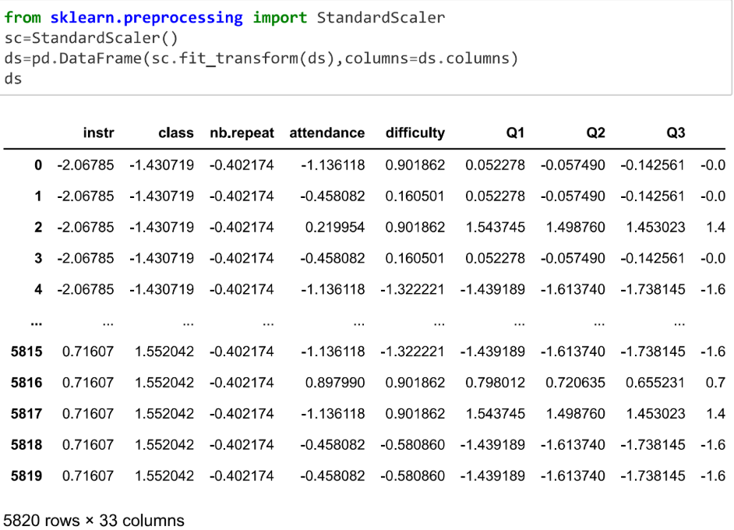
Data Preparation Scaling the whole dataset

Slide 10
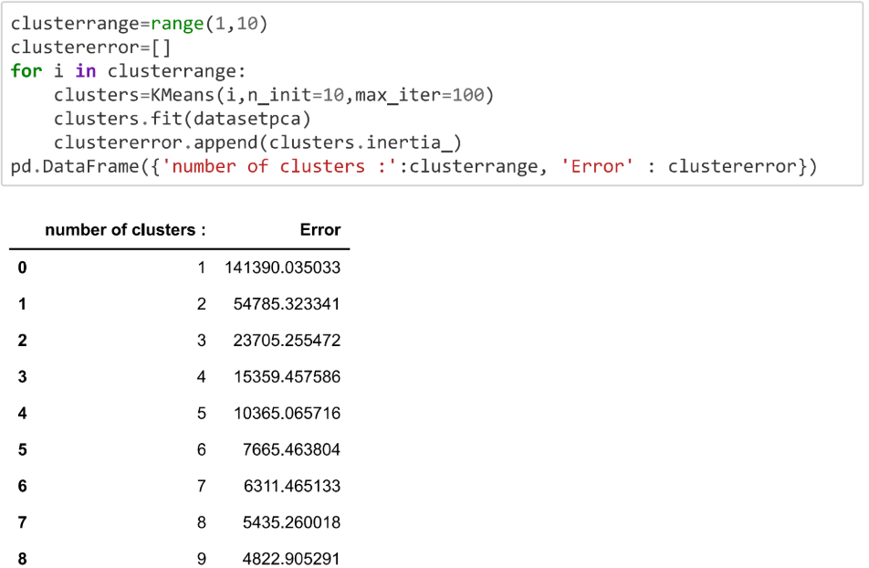
Training Models: K-Means

Slide 11
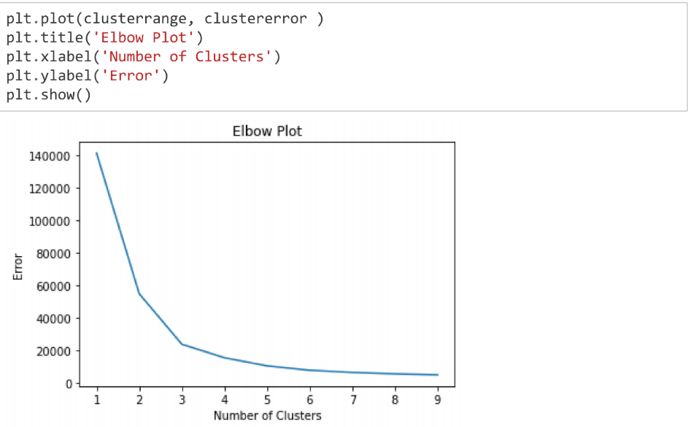
Elbow Method

Slide 12
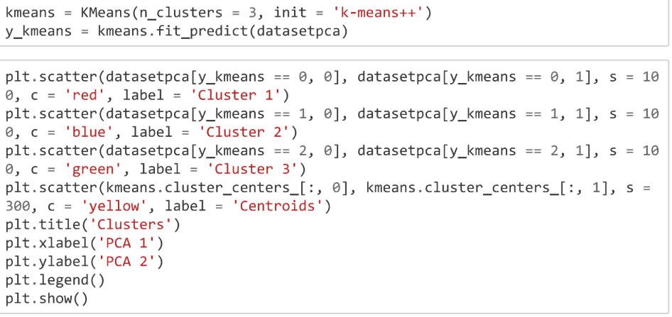
Let’s train the K-Means with 3 clusters:

Slide 13
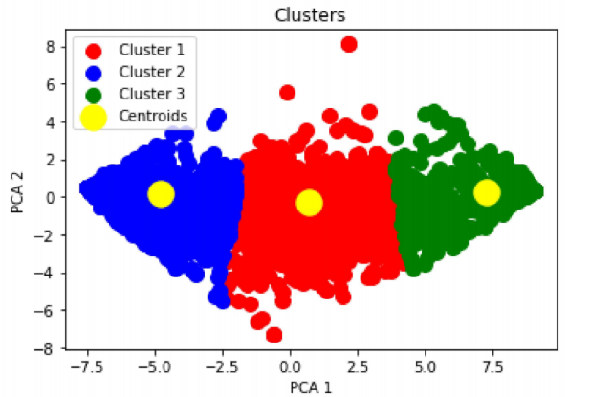
Visualizing the result by scatter plot:

Slide 14
We could see that the observations are tightly grouped (this confirmed our analysis in the Data Exploration earlier) and the clusters are reasonably “natural”.
Let’s see what those clusters mean in the context of answers given by those students. Let’s check the number of observations belonged to each cluster:

Slide 15
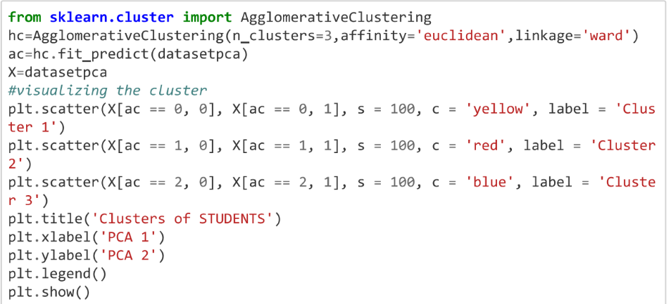
Training Models: Agglomerative Clustering (Hierarchical clustering)

Slide 16
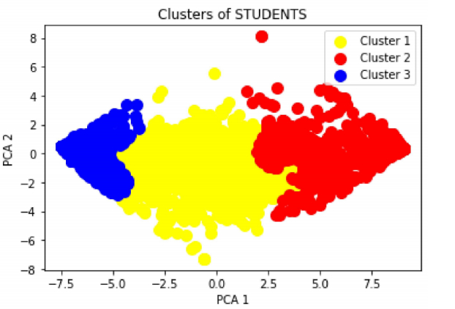
Visualize the result by scatter plot :

Slide 17
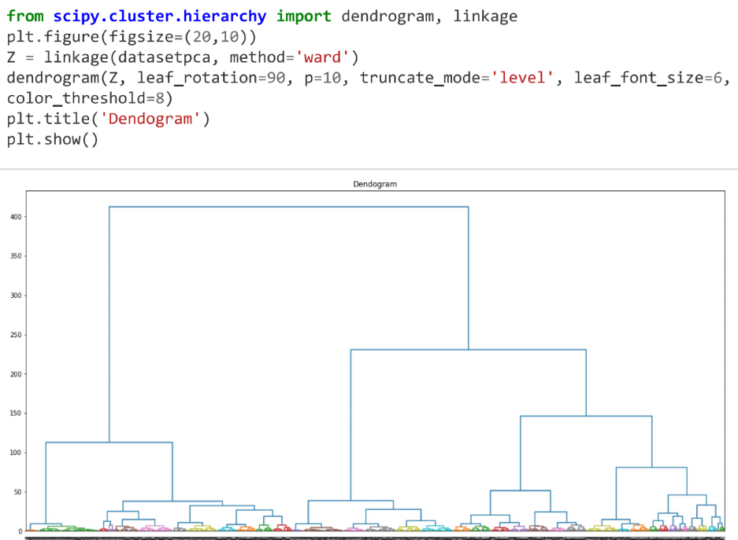
Dendogram from Hierarchical Clustering:

Slide 18
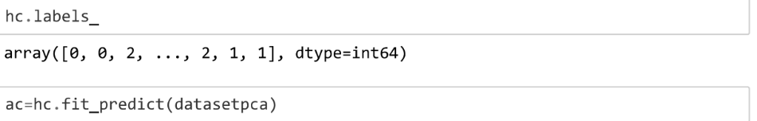
Let’s fit the model with the best k we found earlier

Slide 19
Let’s compare the number of students in each cluster and check the difference: Kmeans:

Slide 20
Agglomerative Clustering:

Slide 21
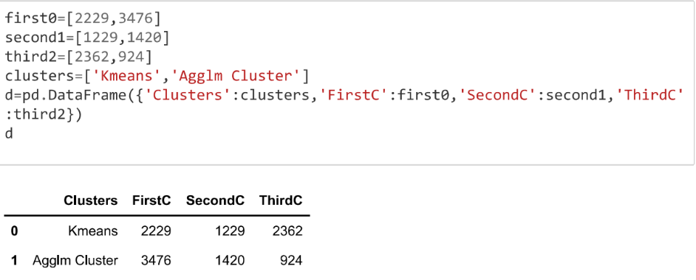
Cross validate by classification accuracy

Slide 22
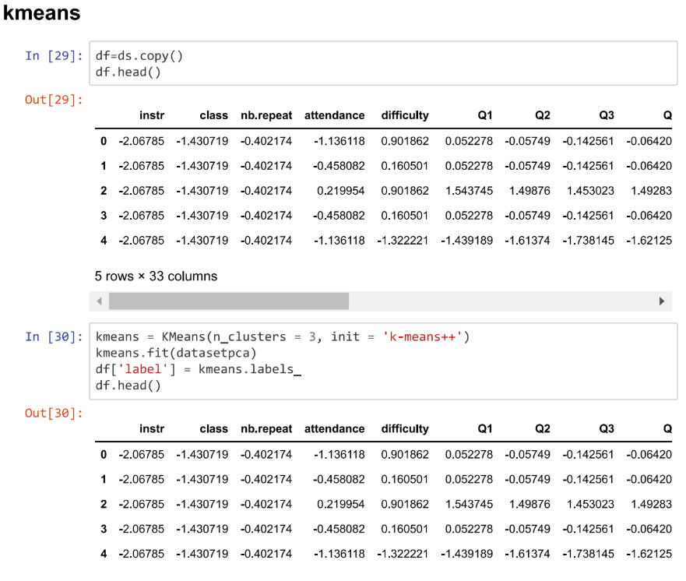
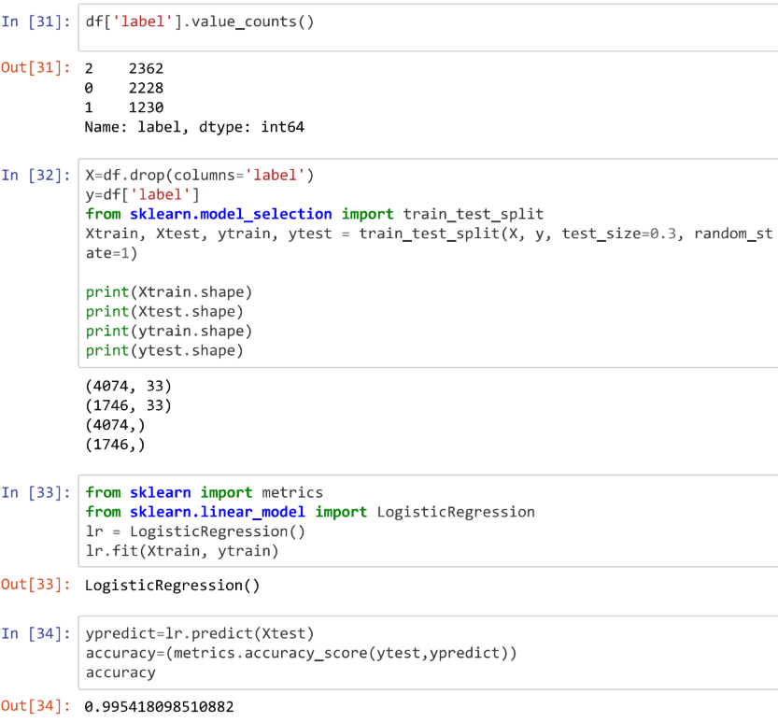
Let us cross validation the dataset by appending clusters group to original data and apply logistic regression to find accuracy.

Slide 23
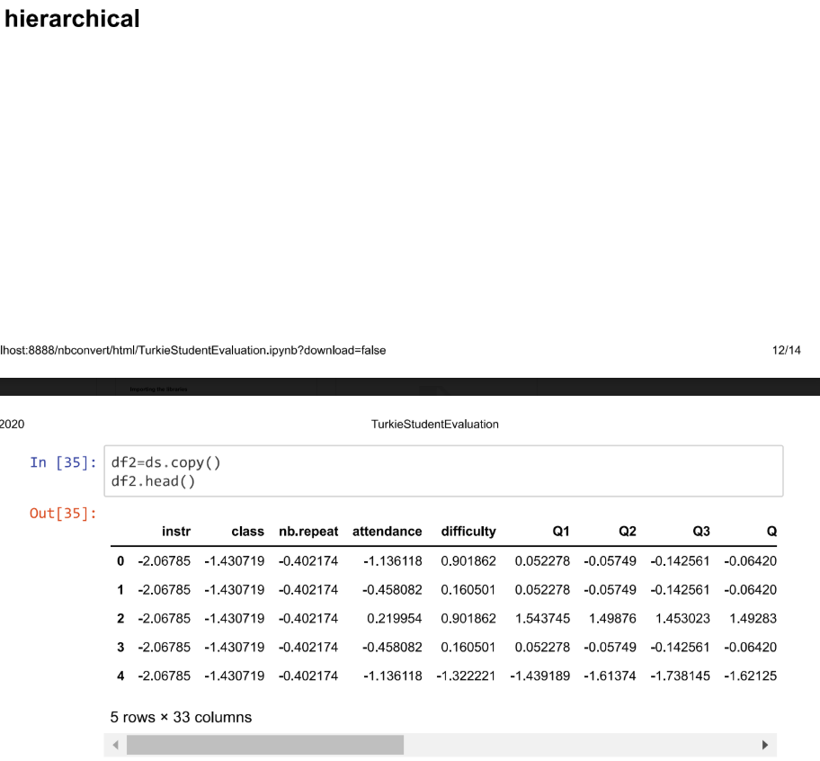
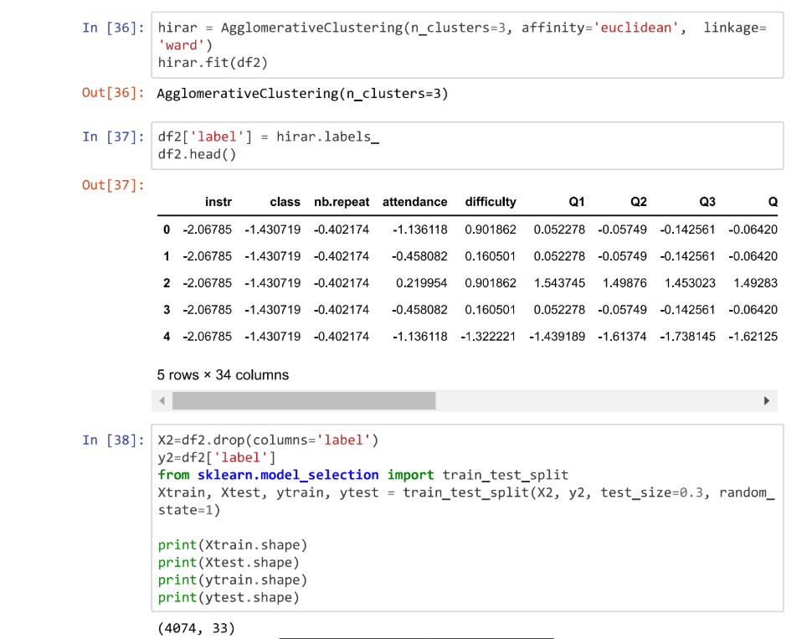
Hierarchical clustering

Slide 24
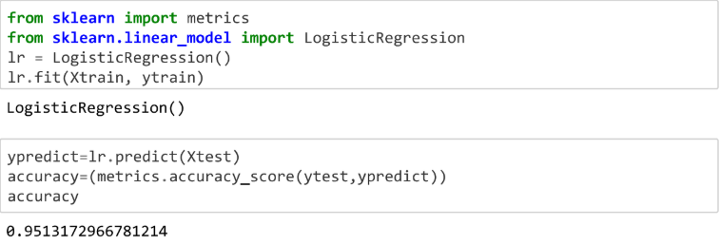

Slide 25
Conclusion
At the end of problem solving, by taking conclusion from elbow method, we used three clusters in k-means and hierarchical clustering.
We also did cross validation for our labeled clusters with logistic regression.
Then, we got 99% accuracy on applying k-means and 95% accuracy on applying hierarchical clustering so we conclude that k-means gives the best clustering groups.

